Slide 1

REMAINING USEFUL LIFE
PREDICTION OF TURBOFAN ENGINES USING A HYBRID CNN-BILSTM-ATTENTION MODEL
A Research Project Based on the NASA CMAPSS Dataset
Khamalesh Ramesh
MSc in Data Analytics
x23325216
National College of Ireland

Slide 2
Introduction to Predictive Maintenance in Aviation
Advanced ML methods revolutionize aircraft maintenance through predictive failure detection reducing AOG incidents and enhancing operational efficiency.
Aircraft Engine Maintenance Types:
1. Corrective: Fix after failure
2. Preventive: Scheduled
3. Predictive: Data-Driven
Why Predictive Maintenance?
Turbofan engines are complex and demand performance + reliability
FAA: 1 failure / 375,000 flight hours
MRO Market: $37.11B (2023) → $47.74B (2029)
RUL Prediction Types:
1. Model-based
2. Data-driven
3. Hybrid

Slide 3
Research Question
How can a hybrid CNN–BiLSTM model, combined with adaptive noise filtering and
domain adaptation techniques, improve the accuracy and generalizability of
aircraft engine Remaining Useful Life (RUL) prediction using the NASA C-MAPSS dataset?
Research Objectives
1. Design a hybrid deep learning architecture using CNN, BiLSTM, and dual attention.
2. Preprocess sensor data with:
· Wavelet denoising
· Rolling statistics
· Delta features
· Normalization
3. Enhance robustness using composite loss (MSE + Huber) to balance outlier sensitivity.
4. Automate tuning using Optuna for hyperparameter optimization across datasets.
5. Evaluate model performance using:
· RMSE (Root Mean Square Error)
· MAE (Mean Absolute Error)
· R² (Coefficient of Determination)

Slide 4
Previous Approaches in RUL Prediction
1. Physics-Based Models
· Use degradation laws, Kalman/particle filters for simulating engine wear
· Limitations: Require deep domain knowledge, poor adaptability to real-world noise
· Zheng et al. (2017): Extended Kalman Filter – RMSE: 192.7 vs. 255.8 (PF)
2. Shallow ML Models
· SVR, Random Forests, MLPs on handcrafted features
· Sherifi (2024): BiLSTM (RMSE: 23.18) outperformed RVR (RMSE: 31.30) on FD002
· Limitations: Fail to capture long-term temporal dependencies
3. Deep Learning Models
· LSTM, BiLSTM, CNN-BiLSTM architectures
· Abedin (2024): LSTM outperformed SVR/MLP on CMAPSS
· Wu et al. (2020): BiLSTM – strong on FD001 (RMSE: 13.65) but weak on FD004 (RMSE: 24.86)
· Limitations: Overfitting, weak generalization, no interpretability
4. Hybrid Architectures with Attention
· CNN–BiLSTM models enhanced with CBAM, dual attention, or EMD fusion
· Guo et al. (2023): Dual Attention – RMSE: 12.25 (FD001) to 19.86 (FD004)
· Zhang et al. (2024): CBAM attention boosted FD001 interpretability
· Limitations: Mostly tested on FD001; high computational cost
5. Signal Denoising & Optimization
· Few studies used adaptive noise filtering like wavelets
· Zhao et al. (2024): CSI-EMD + CNN–BiLSTM – promising but unstable at signal edges
· Yildirim & Rana (2024): Used Optuna for BiLSTM tuning (only on FD001)
· Limitations: No generalizable, tuned pipeline across FD001–FD004
Identified Research Gaps
· Weak generalization across CMAPSS subsets
· Lack of robust noise filtering
· Rare use of interpretable models or automated tuning methods

Slide 5
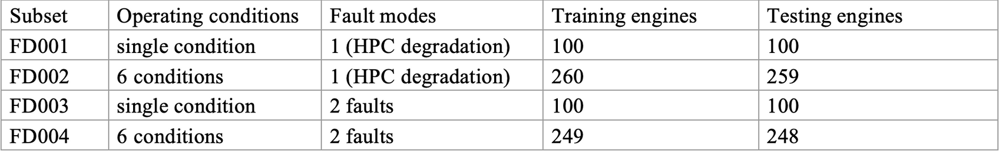
NASA C-MAPSS Dataset
A realistic simulation dataset for aircraft engine degradation modeling.
Preprocessing Pipeline
1. Sensor Pruning: Remove low-variance or flatlined sensors to reduce noise
2. Wavelet Denoising (db4): Smooth high-frequency noise using Discrete Wavelet Transform
3. Normalization: MinMaxScaler + Yeo-Johnson PowerTransformer to reduce skew
4. Temporal Feature Engineering:
· Rolling mean & std (5-cycle window)
· Delta (first difference) features
5. Sequence Generation: Overlapping sequences of 20–35 cycles (subset-specific)
6. RUL Labeling: Piecewise-linear label strategy with cap at 125 for stability

Slide 6
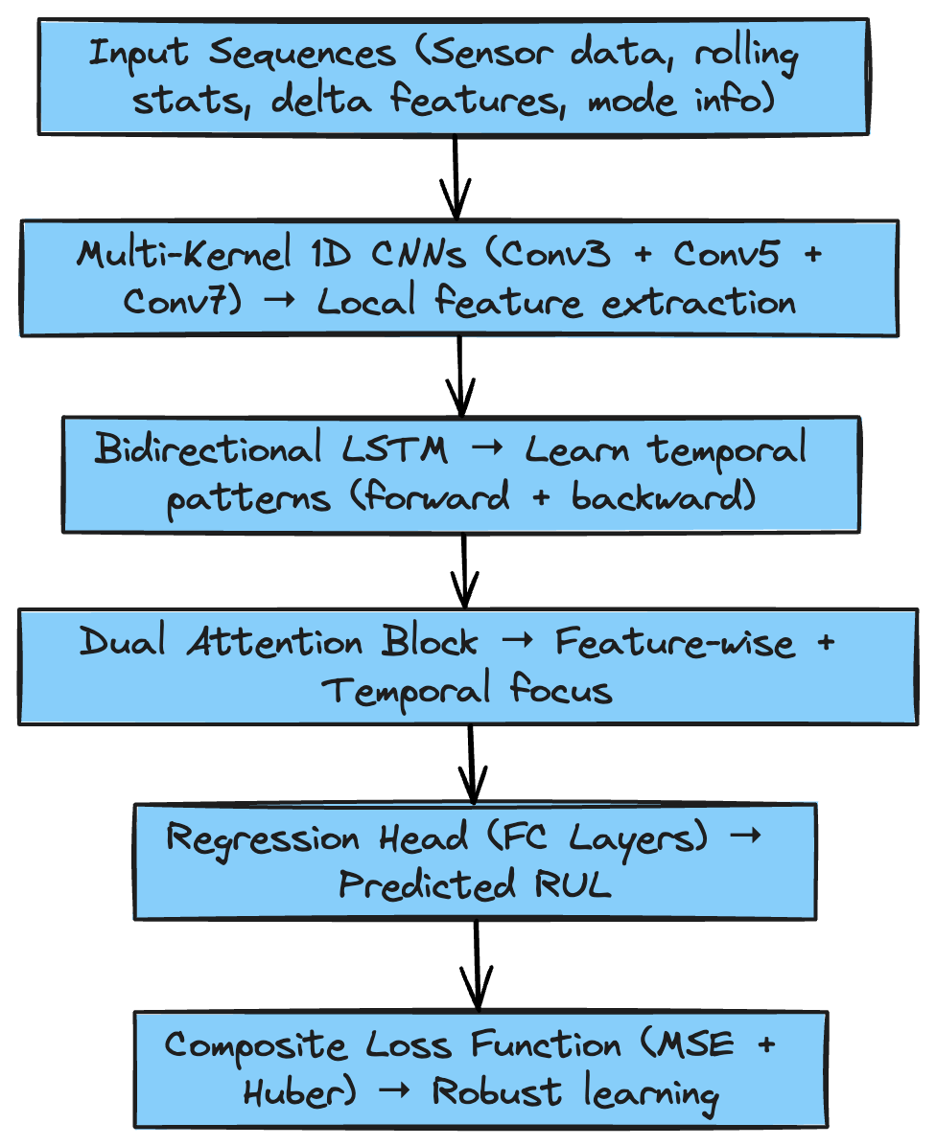
Hybrid CNN–BiLSTM–Attention Model for RUL Prediction
Flow Diagram:
Core Components
1. Multi-Kernel 1D CNNs
· Three parallel Conv1D layers with kernel sizes 3, 5, and 7
· Capture local degradation patterns across different time scales
2. Bidirectional LSTM (BiLSTM)
· Learns temporal dependencies from both past and future cycles
· Outputs a rich, bidirectional representation of engine wear trends
3. Dual Attention Mechanisms
· Feature-wise Attention: Focus on informative sensors (e.g., S7, S13)
· Temporal Attention: Highlight critical time steps (e.g., onset of rapid degradation)
4. Regression Head
· Fully Connected Layers → Scalar RUL Prediction
· Output shape: [batch_size]
5. Composite Loss Function
· Combines MSE (sensitive to large errors) + Huber (robust to outliers)
· Enables noise-resilient learning on complex datasets (e.g. FD004)

Slide 7
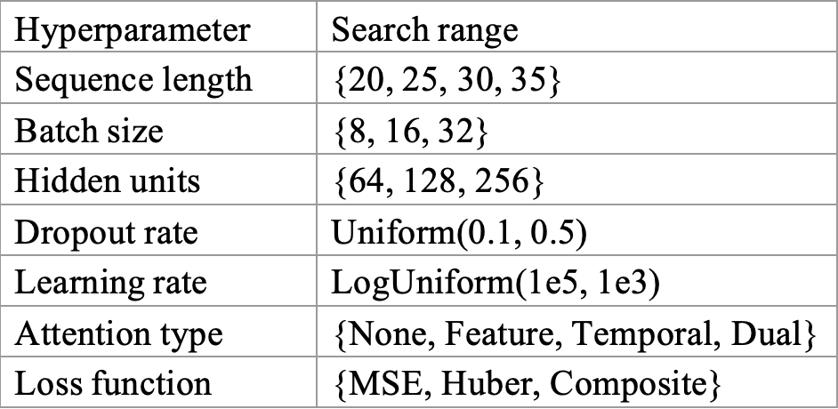
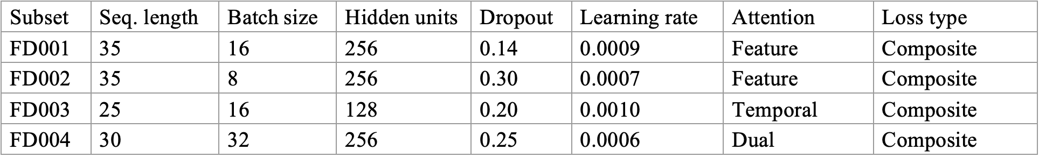
Optuna-Based Tuning Across CMAPSS Subsets
Why Hyperparameter Tuning?
Deep models are highly sensitive to parameters like:
Sequence length
Batch size
Dropout
Learning rate
Manual tuning is inefficient and prone to overfitting
Optuna Optimization Setup
Framework: Optuna (Bayesian optimization + pruning)
Objective: Minimize RMSE on validation set
Search space:
Best Configs per Subset:

Slide 8
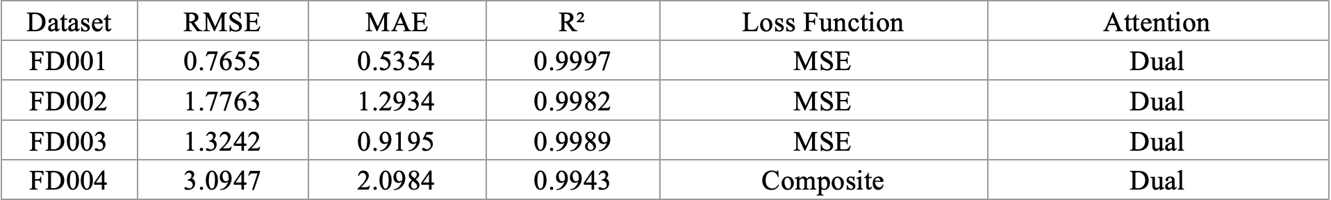
Performance Across CMAPSS Subsets
Results Overview:
Key Observations
1. Consistently high performance across all datasets with R² > 0.99
2. Lowest errors in FD001 due to single fault and operating regime
3. Slightly higher errors in FD004 due to complex multi-regime + multi-fault nature
4. Dual attention + wavelet denoising provided strong generalization
5. Composite loss helped stabilize training under sensor noise and outliers
6. Results validate the pipeline’s ability to scale from simple to complex degradation patterns

Slide 9
Modular, Interpretable, and Deployment-Ready Framework
Modular Architecture:
Organized into clean functional layers:
Promotes clarity, easy debugging, and rapid experimentation
End-to-End Reproducibility:
Every step from raw data to prediction is logged and versioned
CSV snapshots at each preprocessing stage
Metrics and predictions stored in a structured format for analysis and review
Ensures consistent results across different runs with fixed random seeds
Interpretability by Design:
Feature-wise attention: Focuses on most informative sensors
Temporal attention: Identifies critical time windows in engine life
Transparent architecture: Each layer contributes interpretable insights
Real-World Integration Focus:
Trained models are saved and reloadable for live inference
Logs, plots, and checkpoints structured for audit and deployment
Compatible with low-latency predictive maintenance systems

Slide 10
Conclusion & Future Scope
Summary of Contributions:
1. Developed a hybrid CNN–BiLSTM–Attention model for accurate RUL prediction
2. Integrated wavelet-based denoising, temporal feature engineering, and composite loss to handle noisy, real-world data
3. Applied Optuna-based tuning across all CMAPSS subsets for maximum generalization
4. Achieved state-of-the-art results with R² > 0.99 on all subsets
5. Modular design ensures traceability, reproducibility, and interpretability
Future Enhancements
1. Explore Transformer-based architectures (e.g., TFT, Informer)
2. Add SHAP or LIME for improved explainability
3. Deploy to edge systems with model pruning and quantization
4. Combine with physics-informed modeling for hybrid learning
5. Expand application to other industrial sensor datasets

Slide 11
Thank You !!

